Slide 1
Harnessing the Power of Chat-GPT in Clinical Medicine Pre-Workshop Preparations

Slide 2
PRE-WORKSHOP ITEMS
Register for OpenAI Key
Register Google Account
Test access on Google Colab with your Google Account
If you have any question, please email le.quan@sgh.com.sg or daniel.lim@mohh.com.sg

Slide 3

Register OpenAI Key
Go to https://openai.com/
Click “Get Started”
Create new account with email address & password
Go to your Email and verify Email Address
Onboarding: Key in Name, DOB & Organization Name (Optional)
Verify your phone number

Slide 4
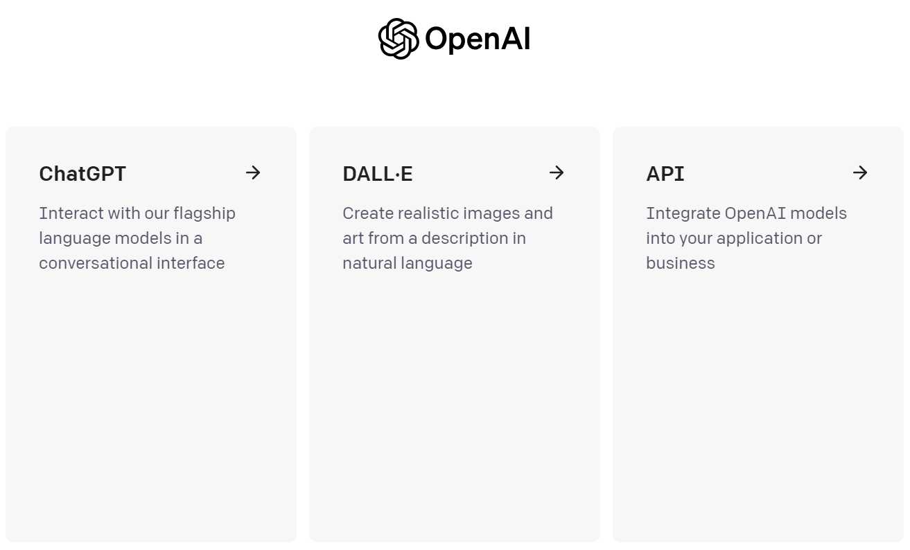
Register OpenAI Key
Log in to created OpenAI Account
Choose API

Slide 5
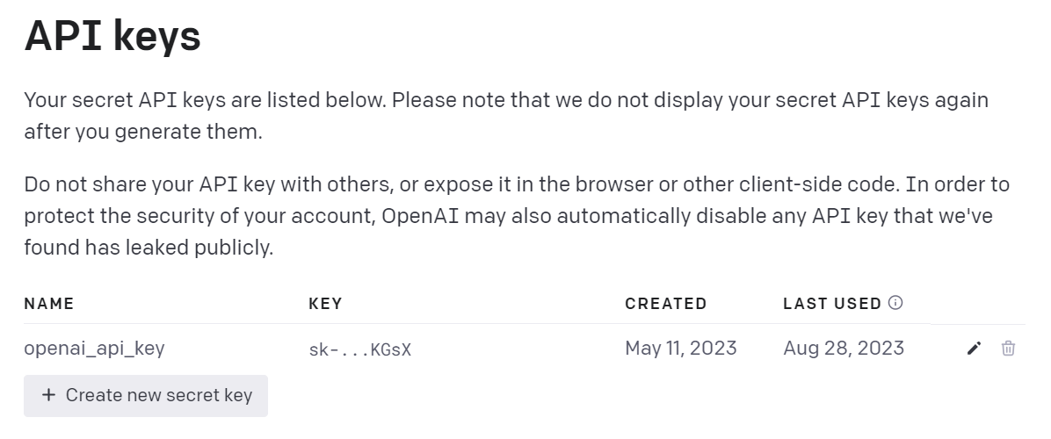
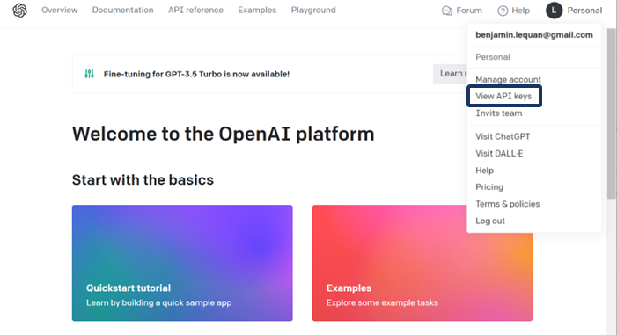
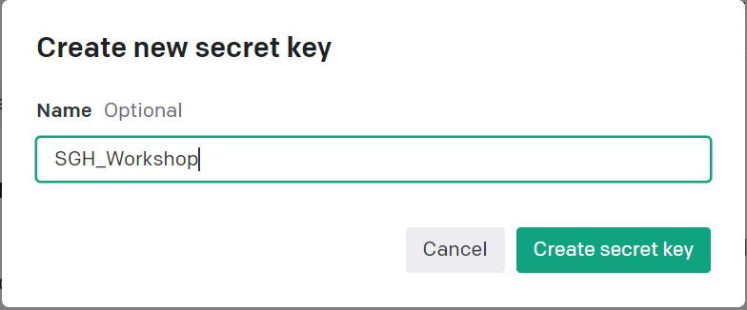
Register OpenAI Key
Navigate to Personal -> View API Keys
Create new secret key -> Enter Name -> Create secret key

Slide 6
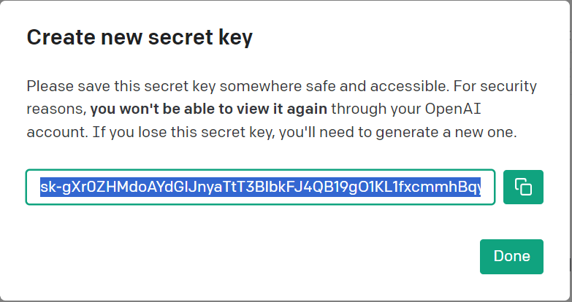
Register OpenAI Key
11. Copy Secret Key to secret and accessible location.
12. Don’t share your API Keys with others

Slide 7

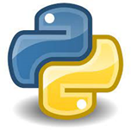





Google Colaboratory
- Write and Execute Python code in browser
- Pre-built working environment with rich library
- Connection to Google Drive Storage
- Easy sharing of codes for collaboration
- Free GPU Resources for training DL models
- Create a Google Account to get started
https://colab.research.google.com

Slide 8
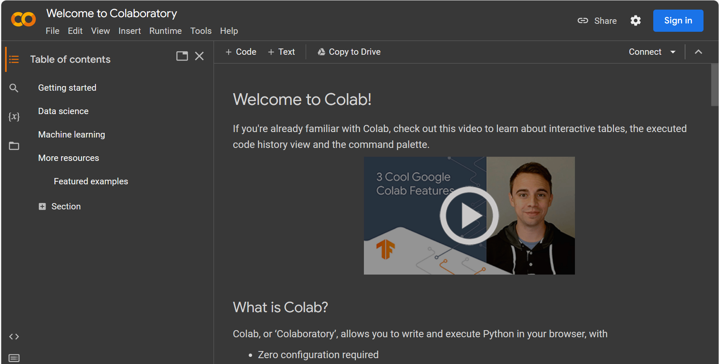
Sign in Google Colab
Navigate to Google Colab homepage: https://colab.research.google.com
- Sign In with Google Account credentials
Workspace

Slide 9
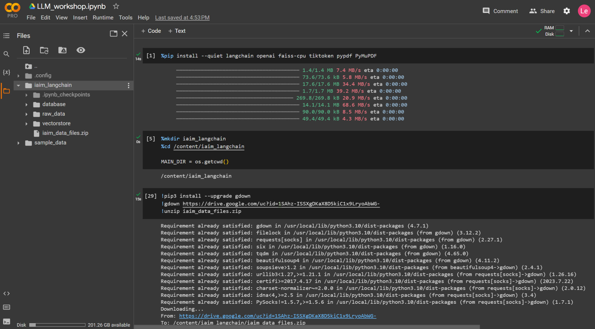
Getting Started with Google Colab
Resources
Workspace
Directories
Terminal

Slide 10
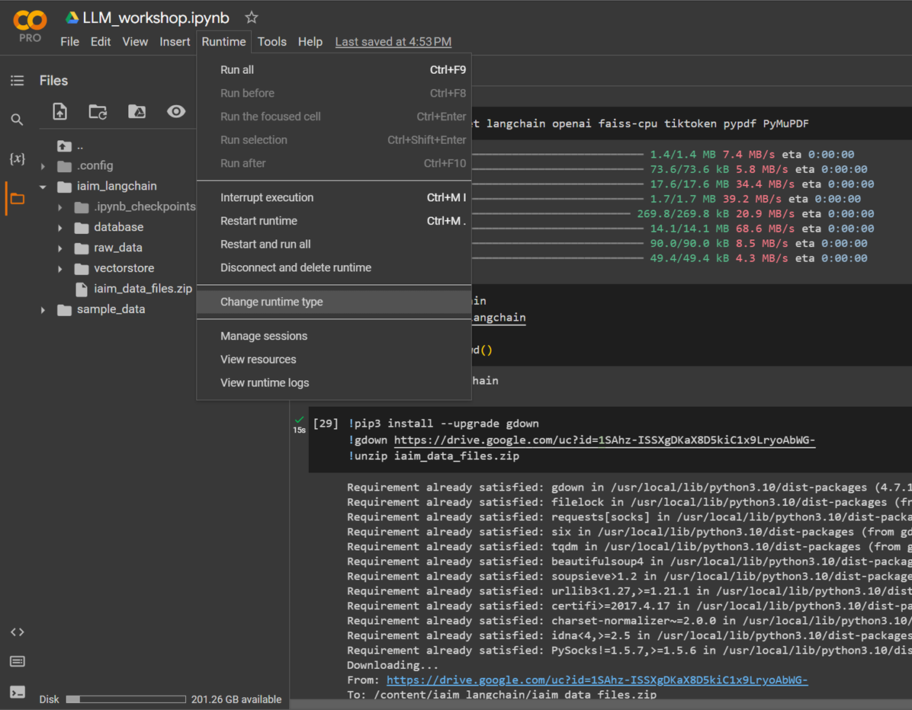
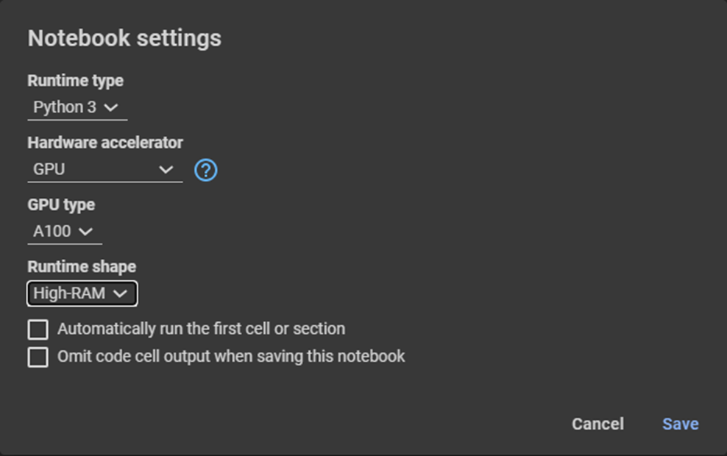
Activate GPU resources on Colab
Select Runtime -> Change Runtime type
From Hardware Accelerator, select GPU

